Slide 1
Mini Intro to Python

Slide 2
Intro to Python
Popular high-level imperative programming language
Download Python from www.python.org
Versions 3.6.2 & 2.7.13
Run from Command Line or IDLE (IDE)
Why use it?
Lots of users
Platforms
Libraries and tools

Slide 3
Python Tutorial
http://otree.readthedocs.io/en/latest/python.html

Slide 4

Comments

Slide 5
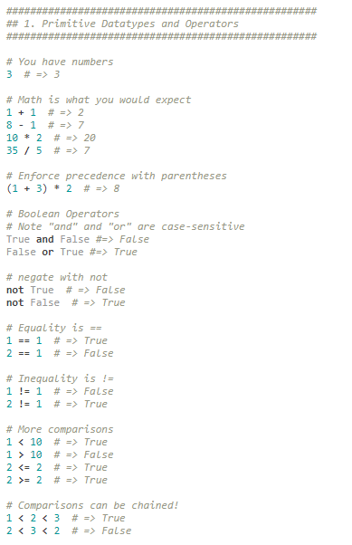

Slide 6
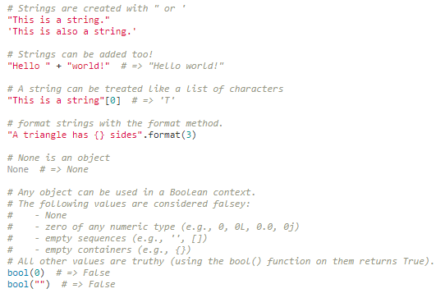

Slide 7
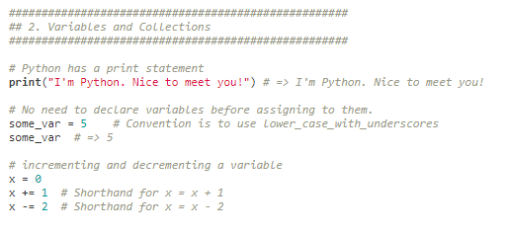

Slide 8
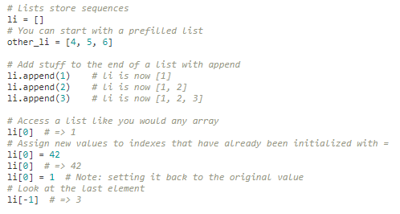

Slide 9
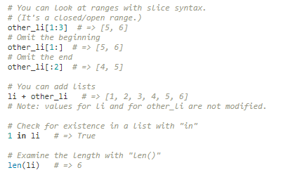

Slide 10
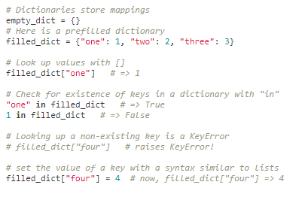

Slide 11
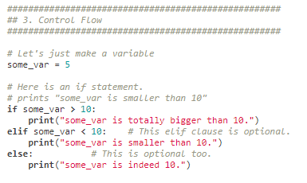

Slide 12
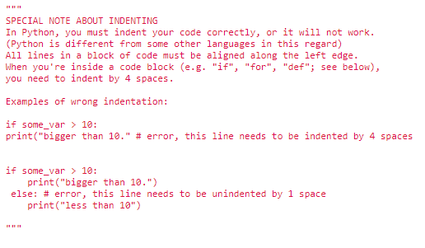

Slide 13
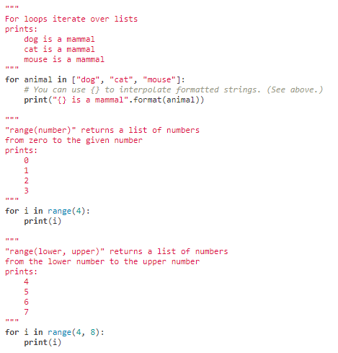

Slide 14
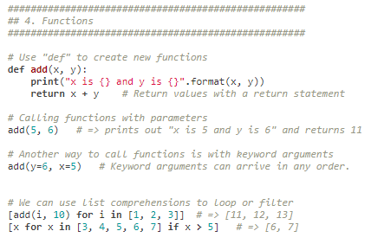

Slide 15
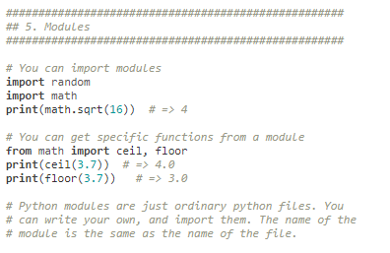

Slide 16
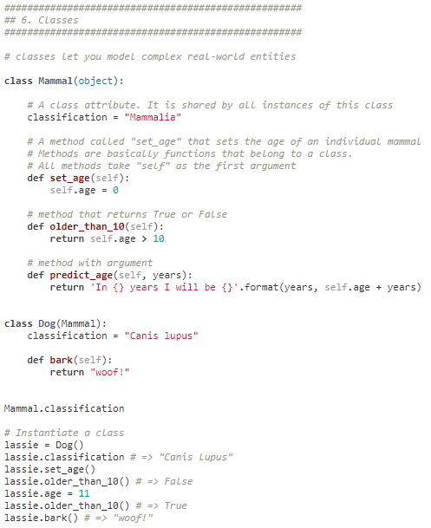

Slide 17
Help
Google!!
SCIC Tutors
Free online book: http://greenteapress.com/wp/think-python-2e/

